Slide 1

Status update on Mobility and Transport related key policy and initiatives in South and Southeast Asia
Ms. Saoni Sanyal
Dr. Himani Jain
18th March, 2026
© Council on Energy, Environment and Water, 2026

Slide 2
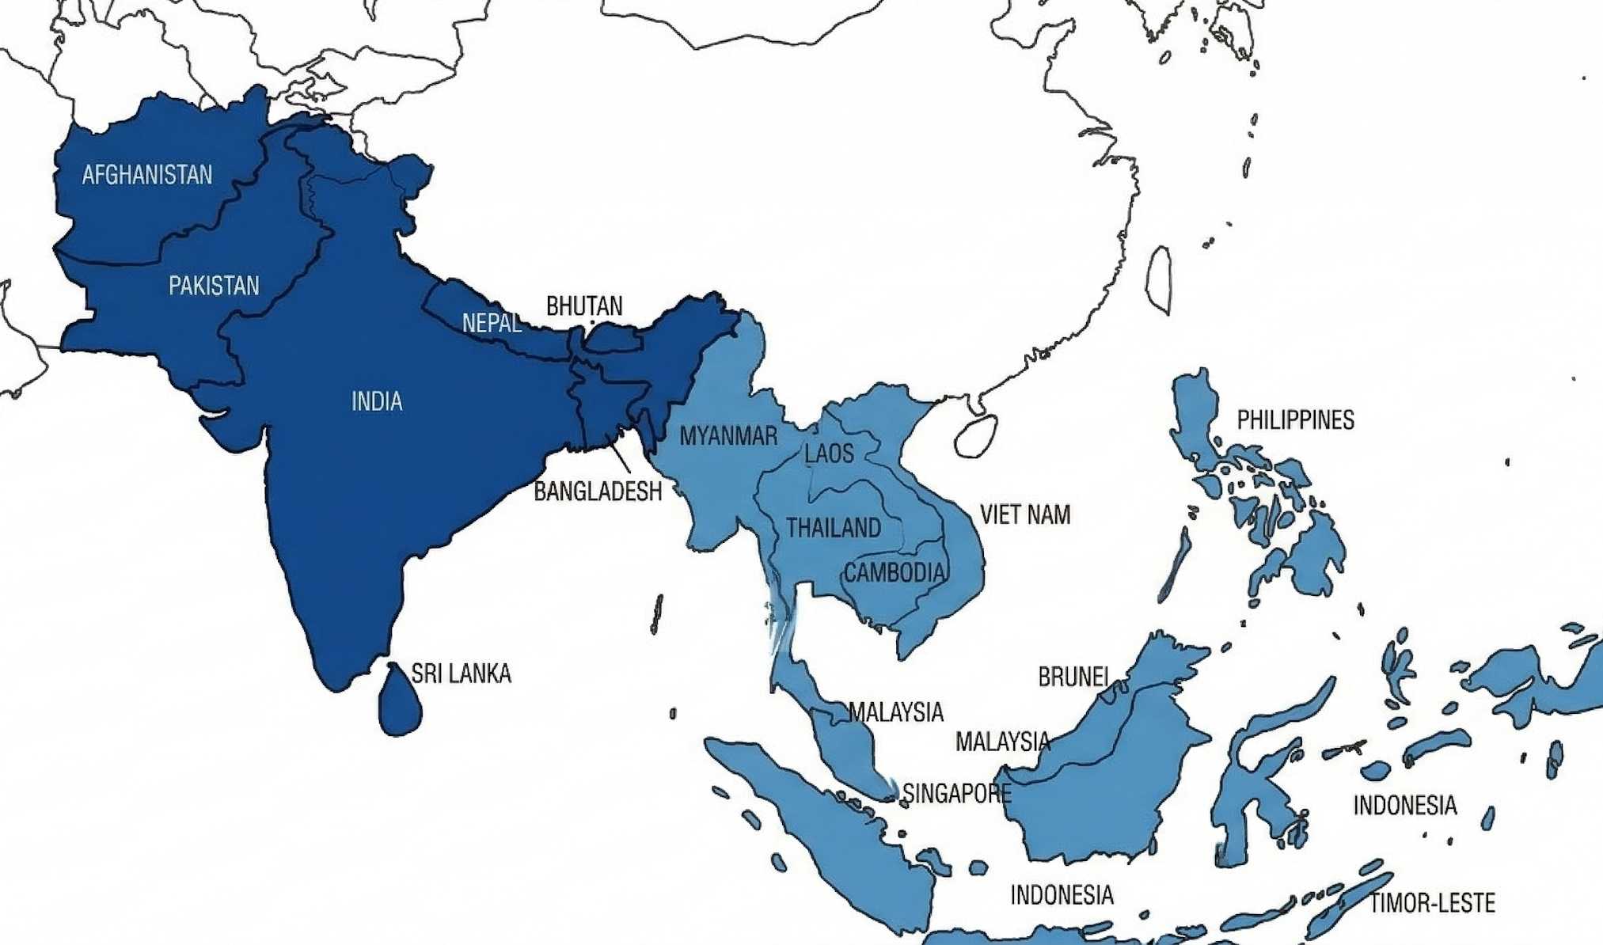
Urbanization Characteristics of South Asia
Country – Afghanistan
Area- 652230 sq km
Population – 45 million
Urbanized area- 26.21 per cent
Avg Density – 69 pp/sq km
Country – Pakistan
Area- 881913 sq km
Population – 259 million
Urbanized area- 39.88 per cent
Avg Density– 294 pp/sq km
Country – India
Area- 3,287,263 sq km
Population – 1476 million
Urbanized area- 39.88 per cent
Avg Density– 449 pp/sq km
Country – Nepal
Area- 147181 sq km
Population – 29 million
Urbanized area- 21.00 per cent
Avg Density– 201 pp/sqkm
Country – Bhutan
Area- 38,394 Sq km
Population – 0.8 million
Urbanized area- 44.33 per cent
Avg Density – 21 ppl/ sq km
Country – Bangladesh
Area- 147,570 sq km
Population – 177 million
Urbanized area- 33.84 per cent
Avg Density - 1205 pp/ sq km
Country – Sri Lanka
Area- 65,610 sq km
Population – 23 million
Urbanized area- 20.60 per cent
Avg Density – 356 pp/ Sq km
Population is 2026 estimated by World Population Review

Slide 3
Urbanization Characteristics of Southeast Asia
Country – Philippines
Area- 300,000 sq km
Population – 116 million
Urbanized area- 56.09 per cent
Avg Density– 392 pp/sq km
Country – Malaysia
Area- 330,803 sq km
Population – 34 million
Urbanized area- 77.88 per cent
Avg Density – 102 pp/sq km
Country – Vietnam
Area- 331.212 sq km
Population – 101 million
Urbanized area- 41.00 per cent
Avg Density– 307 pp/sq km
Country – Indonesia
Area- 1,904,569 sq km
Population – 284 million
Urbanized area- 60.04 per cent
Avg Density – 144 pp/sq km
Country – Mayanmar
Area- 676,578 sq km
Population – 54 million
Urbanized area- 30.74 per cent
Avg Density– 201 pp/sqkm
Country – Singapore
Area- 719 sq km
Population – 6.1 million
Urbanized area- 100
Avg Density – 8261 pp/sq km
Population is 2026 estimated by World Population Review

Slide 4
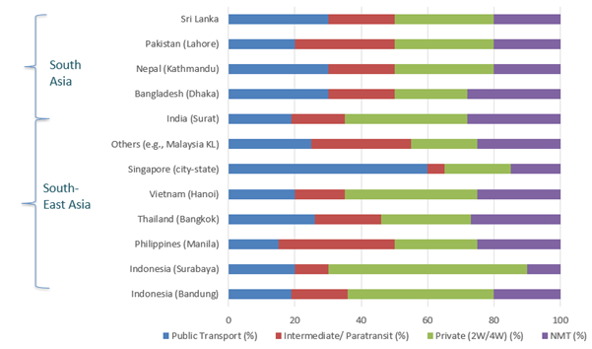
Low Public Transport Share (mostly >20 per cent ) Drives Growth of Informal Intermediate Public Transport (IPT) Vehicles (20-25%)
Fig Source- CEEW Analysis
Source- Vanderschuren, Marianne, and Jennifer Louisa Baufeldt 2018. Framing the Third Cycling Century-Bridging the Gap between Research and Practice. German Environment Agency /Tiwari, Geetam, and Nishant . 2018. Travel to Work in India. India: TRIPP, IIT Delhi/ IFT Transport Outlook . OECD. 2015

Slide 5
Singapore and Vietnam have highest EV sales in 2025 (Q1)
Percentage of Ev sale in new vehicle sales
73 percent of South and South East Asian countries have active EV subsidy and schemes
🇸🇬 Singapore
🇻🇳 Vietnam
Highest EV adoption in ASEAN. Congestion ERP system + aggressive ARF rebates driving uptake.
VinFast domestic brand drove near doubling YoY. E-motorcycle volumes up 99.2% in H1 2025.
~40%
~40%
🇮🇩 Indonesia
EVs tripled in 2024 surpassing US for first time. 34% CAGR expected through 2030. BYD plant online.
🇹🇭 Thailand
Chinese imports 85% of EV sales. EV3.5 program requires local mfg by end-2026.
15%
21%

Slide 6
Initiatives taken in South and South- east Asian cities for LEZ and Road Pricing Policies
🇸🇬 Singapore
🇮🇩 Indonesia — Jakarta
ACTIVE
ACTIVE (Limited)
World's most mature pricing system. ERP (Electronic Road Pricing) since 1975 — cordon-based congestion charges. Transitioning to GPS-based Electronic road pricing 2.0. EVs get reduced charges. No new ICE cars from 2030.
LEZ in Kota Tua (Old Town, 0.14 km²) since 2021. Tebet Eco Park LEZ on weekends. ADB TA supporting expansion to other polluted urban districts (Jakarta, Surabaya, Bandung).
🇻🇳 Vietnam — Hanoi
🇵🇭 Philippines
PLANNED (2025)
PILOTING
Capital Law 2024 mandates LEZs in Hoan Kiem & Ba Dinh districts (Hanoi) starting Jan 1, 2025. HCMC and Hanoi studying congestion pricing feasibility.
ADB TA for LEZ feasibility in Manila. EV Industry Development Act 2022 sets 5% EV fleet mandates — indirect emission zoning via procurement.
🇹🇭 Thailand — Bangkok
🇮🇳 India — Select Cities
STUDYING
EMERGING
Congestion cost in Bangkok estimated at $15.4 billion/year. Pricing threshold suggested at >$2.3/entry. No formal LEZ or Electronic road pricing yet implemented; Bangkok remains under study.
Kevadia (Gujarat) LEZ operational. Delhi odd-even plate rules and GRAP (Graded Response Action Plan) emission-based restrictions during peak pollution periods.

Slide 7
Regional Overview of South and South East Asian cities
8/11
1
8+
2
Countries with Net Zero
Goals
EV30@30 Signatory
(India)
Active EV Subsidy
Schemes
Active LEZ Cities
(SG + Jakarta)
Country | Net Zero | EV30@30 | Active EV Scheme | EV Sales Trend | LEZ / Pricing
India 🇮🇳 | 2070 | ✅ Yes | PM E-DRIVE, PLI, EMPS | ↗ 7% penetration (FY24) | Kevadia LEZ; Odd-Even Delhi
Singapore 🇸🇬 | 2050 | ❌ No | ARF Rebate 45%; VES | ↗↗ ~40% share 2025 | ✅ ERP since 1975 (world's oldest)
Thailand 🇹🇭 | 2065 | ❌ No (own 30@30) | EV3.5 scheme | ↗↗ 21% share 2025 | Studying; no formal LEZ
Vietnam 🇻🇳 | 2050 | ❌ No | Reg. fee waiver 2027 | ↗↗↗ ~40% share 2025 | Planned: Hanoi LEZ (2025)
Indonesia 🇮🇩 | 2060 | ❌ No | Luxury tax 0%; VAT 1% | ↗↗ 15% share 2025 | ✅ Jakarta Kota Tua LEZ (2021)
Malaysia 🇲🇾 | 2050 | ❌ No | Duty waivers; road tax exempt | ↗ 4% share 2024 | No formal LEZ
Philippines 🇵🇭 | No target | ❌ No | EV Industry Dev. Act 2022 | ↗ Early stage | Piloting (ADB TA)
Cambodia 🇰🇭 | 2050 | ❌ No | NDC-focused; minimal | → Very early | None
Myanmar 🇲🇲 | 2040 (LULUCF) | ❌ No | None | → Very early | None
Laos 🇱🇦 | 2050 | ❌ No | Limited | → Very early | None
Brunei 🇧🇳 | 2050 | ❌ No | Minimal | → Very early | None

Slide 8




Public transportation and electrification initiatives in South and South East Asian Countries
Country | Focused Vehicle segment | Targets / Vision (next ) | Subsidy Mechanisms | Current Status
Philippines |  | PUV Modernization Program; long-term low- carbon mobility vision-Targets include around 100,000 e‑trikes/year and 200,000 e‑jeepneys over six years, supported by purchase subsidies and concessional loans | Capital subsidy per e-jeepney; concessional loans via development banks; tax exemptions | Status - SLOW / CONTESTED As of 2025, only ~5% of 220,000 jeepneys have been electrified, though 2025 saw acceleration with >1,000 e-jeepney units deployed.
Singapore |  | Target for 100% cleaner energy vehicles by 2040 | Government procurement model; charging infrastructure integrated with depots; strong fiscal capacity A 25% purchase subsidy advances full electrification by 8 years | Status - ON TRACK LTA has deployed 70+ electric buses as of end-2024 and awarded contracts for 660 new electric buses (360 single-deck + 300 double-deck) to be deployed from end-2026.
Thailand |  | National EV roadmap (30@30 policy); EV production hub ambition National Energy Efficiency Plan targets 1.2 million EVs by 2036; NSTDA plan to make Thailand an ASEAN BEV hub with capacity to produce 1,000 electric buses/year | Excise tax reductions; investment incentives; public-private partnerships | Status – ON TRACK As of July 2025, ~3,800 electric buses and trucks are on the road.

Slide 9
Country | Focused Vehicle segment | Targets / Vision | Subsidy Mechanisms | Current Status
Malaysia |  | Low Carbon Mobility Blueprint; carbon neutrality by 2050 NAP 2014 envisaged 100,000 EVs by 2020 and investments of about RM150 million, including deployment of around 100 electric buses through purchases and leasing in selected corridors | Green Technology Financing Scheme; EV import tax exemptions | Status - MODERATE PACE Prasarana Malaysia roll out 250 electric buses in 2025
Indonesia |  | Net-zero target by 2060; electrification of public fleets National Battery Electric Vehicle (KBLBB) program plans public‑sector procurement of 132,000 EVs and 2.45 million e‑motorcycles by 2030, with local firms preparing electric bus production for mass transport | Fiscal incentives; reduced import duties; PLN-led charging infrastructure | Status - SLOW / CONTESTED As of 2025, only 376 electric buses are operating across 5 cities (Jakarta ~300+, Medan 60, Surabaya 12, Yogyakarta & Semarang pilots). Transjakarta has ~470 e-buses out of 5,000 total fleet.
Laos |  | Sustainable transport under climate commitments “Strategy on Clean Energy Use and Promotion in the Transportation Sector – Development Plan 2025, Strategy 2030, Vision 2050-explicitly using EVs to absorb surplus hydropower and reduce oil imports | Limited structured subsidy; donor-supported pilots | Status – PILOT Vientiane Sustainable Urban Transport Project launched its first 55 electric buses in a BRT system trial in June 2025,
Pakistan |  | National EV Policy (30% EV by 2030) | Reduced import duties; provincial pilot procurement; concessional financing | Status – PILOT Lahore has deployed a small fleet of electric buses with GPS, Wi-Fi, disability ramps, and dedicated charging stations. Karachi pilots also ongoing.

Slide 10

Country | Focused Vehicle segment | Targets / Vision | Subsidy Mechanisms | Current Status
Nepal |  | Clean energy transition vision; reduce fossil fuel imports- SET4NPL project aims to easy electrification of IPT segments (Micro and Minibuses) | Customs duty reductions; hydropower-based charging support | Status - ACTIVELY PROGRESSING SET4NPL project is actively deploying blended finance and technical assistance to scale electric microbuses/minibuses in Kathmandu Valley and beyond. NDC target of 20% public transport EVs by 2025 partially met in informal IPT segments.
Vietnam |  | Carbon neutrality by 2050; national EV roadmap | Tax incentives; domestic manufacturing support; state-backed charging rollout | Status-GROWING (PRIVATE-LED) VinBus operates ~286+ electric buses across Hanoi (202), Phu Quoc (51), HCMC (33), and Haiphong. Hanoi expanded to 14 electric bus routes in 2025, with all buses on those routes fully electric.
Myanmar |  | Broad climate goals; limited structured EV strategy | Minimal targeted subsidy; pilot-scale introduction | Status - SLOW / CONTESTED Political instability since the 2021 military coup has severely disrupted policy continuity and foreign investment.
India |  | Major initiatives like FAME II/PM E-DRIVE, the National Electric Bus Program (NEBP), and PM-eBus Sewa have spurred the deployment of over 9,700 electric buses by early 2024, with 7,293 approved under PPP models in 110 cities as of August 2025 India observed rapid IPT electrification where over 6 lakh (600,000) electric three-wheeler registrations in 2024 alone, and projections suggest this annual figure could reach 1.4–1.8 million by 2030- supported by FAME II and PM e-Drive | PM-eBus Sewa (2023): A ₹57,613 crore scheme, with ₹20,000 crores central support, aimed at deploying 10,000 electric buses in 169 cities under a Public-Private Partnership (PPP) model, focusing on cities with 3 lakhs+ population. FAME-II & PM E-DRIVE (2019-2026): The FAME II scheme (ending March 2024) supported thousands of e-buses. It has been succeeded by the PM Electric Drive Revolution in Innovative Vehicle Enhancement (PM E-DRIVE) scheme (April 2024-March 2026), with a ₹10,900 crore outlay supporting 14,028 e-buses. | Status- LARGE-SCALE / ACTIVELY DEPLOYING 10,000 e-buses sanctioned across 116 cities (20 states + 6 UTs) under PM-eBus Sewa. Letter of Award issued for 4,787 buses across 67 cities; Concession Agreements signed for 2,630 buses in 31 cities. 4 cities (Guwahati, Chandigarh, Nagpur, Bhavnagar) expected to begin operations Jan–Feb 2026.

Slide 11




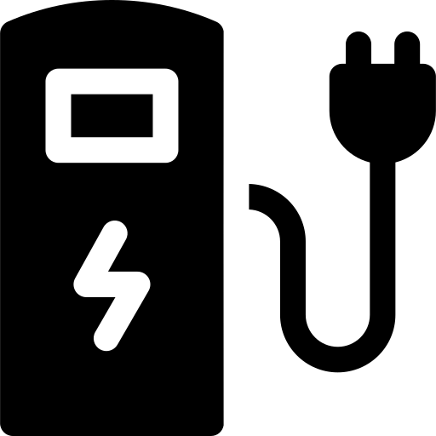

Innovative Clean mobility Initiatives in South and Southeast Asian cities
INNOVATIVE MOBILITY INITIATIVES
MaaS & App-based Transit
Battery Swapping Networks
Singapore's MaaS pilot integrates PT, e-scooters, ride-hail.
Thailand's EV-Shared Mobility (EVAT).
Grab SuperApp rides across 8 SEA countries.
India: Battery Smart (1,000+ stations), Sun Mobility (630 stations).
Gogoro (Taiwan-origin) expanding to India & SEA.
Indonesia's Swap-n-Go by Pertamina.
Shared Micro-mobility & NMT
Smart & Demand-Responsive Transit
Bangkok bike-share (Pun Pun).
Manila Pasig River Ferry + cycling corridors.
Hanoi BRT + e-scooter last mile.
Jakarta TransJakarta bike feeder integration.
Singapore MoD (Mobility on Demand) via AV shuttles.
India's Chalo App for live bus tracking in 50+ cities.
MyCar & GoCar ride-pool in Malaysia.
Green Corridor & Charging Infra
15-Minute City & TOD Planning
India's NH EV charging every 25 km on highways.
Thailand's 17,500+ chargers (EV3.5 target).
Vietnam: VinFast 150,000 charger pledge by 2030.
Singapore's TOD master plan around MRT nodes.
India's AMRUT 2.0 integrates NMT+EV.
Penang's transit-oriented PTMP plan (BRT+LRT+e-feeder).

Slide 12
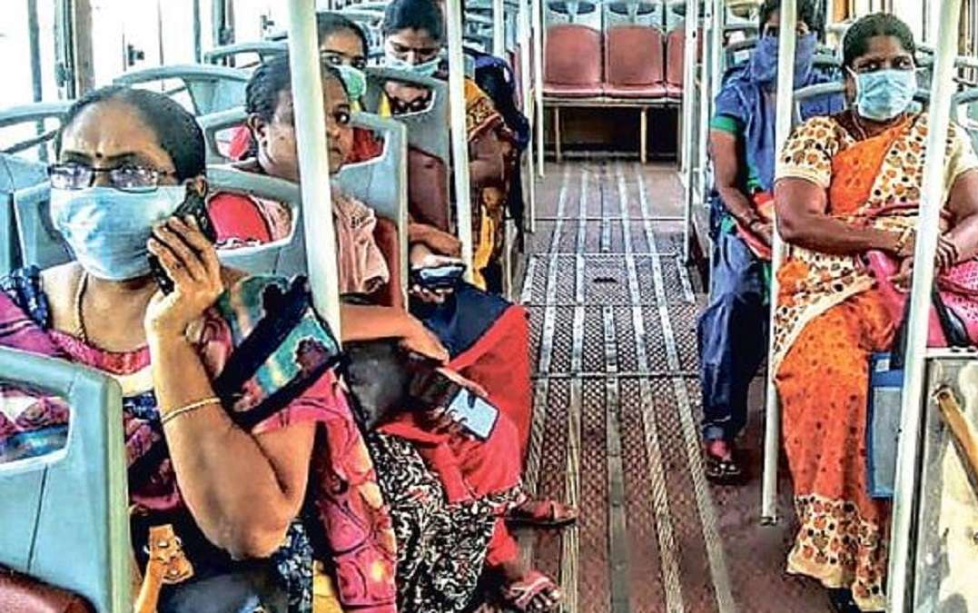
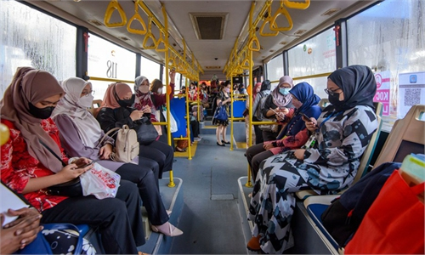
Initiatives on Women safety and Universal access
♀ WOMEN SAFETY & UNIVERSAL ACCESS
🚇
Women-Only Carriages / Buses
♿
Universal Access & Disability Inclusion
Malaysia KTM/LRT dedicated coaches. Indonesia women-only TransJakarta buses (2011).
Vietnam Safe Journey 2024: women-only carriages + 2M awareness campaign.
Singapore fully accessible bus fleet (100%). India SUGAMYA app for disability-accessible transport.
ADB Gender Tool Kit adopted by 6 SEA countries.
📲
Tech-based Safety Solutions
🌏
Regional Frameworks & Guidelines
India: SafeCity crowdsourced harassment mapping (27 cities).
Malaysia: MyRapid app SOS button. Philippines: female-driven jeepneys pilot (2024).
ADB Gender & Transport Tool Kit (2013). UNESCAP Gender-Responsive Urban Transport. EST Forum Goal 5: Urban Access for all (2024, Manila).
👩‍💼
Women in Transport Workforce
💡
Safe Infrastructure Design
Women only 17% of transport workforce in Asia (NDC-TIA 2024).
India Nirbhaya Fund for PT safety.
Vietnam: GIZ gender-responsive transport planning pilot in Hanoi.
Thailand: CCTV + lit bus stops in Bangkok (2024).
Philippines: AI CCTV at MRT stations.
India SHE Teams (Hyderabad) + dedicated women bus queues.

Slide 13
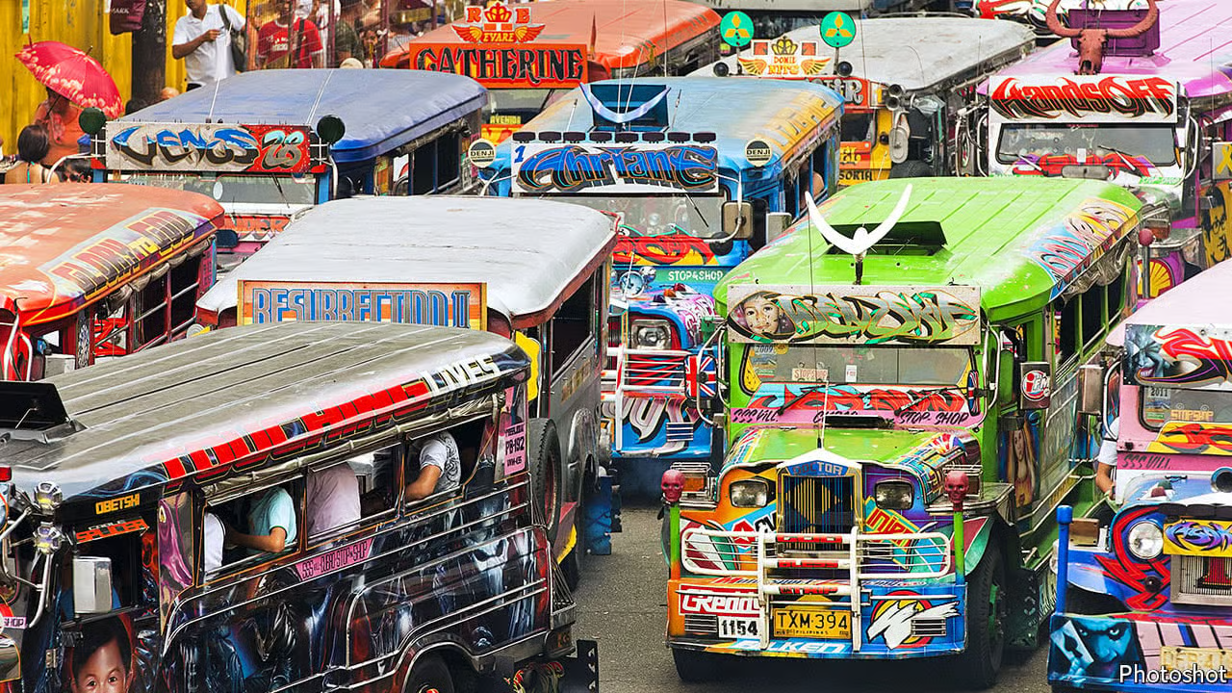
Key Areas to cover in upcoming years
IPT Electrification -
IPT responsible for 20-25 % modal share in urban transport and operates in congested urban roads
Electrifying of this sector will help to reduce urban tailpipe emissions
Microbuses-
Visible gap between low capacity IPTs (6 seaters) and standard buses (25-30 seats)
Smaller electric buses will be better fit -easily navigate through the narrow roads, zero tailpipe emissions and decreasing fleet numbers with efficient services
Bus Electrification –
Transitioning urban bus fleets to electric in South and Southeast Asian cities can dramatically cut tailpipe emissions and reduce dependence on fossil fuels, directly improving air quality in dense, polluted urban corridors
Promoting NMT and Micro mobility –
Dedicated cycling lanes, pedestrian walkways, and affordable shared e-scooters or bikes , offers low-carbon last-mile connectivity that complements mass transit in rapidly growing cities

Slide 14
Potential Partner Institutes and Agencies
TDRI
Thailand Development Research Institute
ISEAS
ISEAS – Yusof Ishak Institute
SEI
Asia
Stockholm Environment Institute (SEI) Asia
Bangkok, Thailand · Est. 1984
Singapore · Est. 1968
Bangkok, Thailand · Mekong region
Thailand
Transport policy
Singapore
ASEAN policy
Mekong region
Just transition
ERIA
Economic Research Institute for ASEAN and East Asia
PIDS
Philippine Institute for Development Studies
CEERD
Centre for Energy, Environment & Resources Dev.
Jakarta, Indonesia · Est. 2008
Quezon City, Philippines · Est. 1977
Bangkok, Thailand
Official ASEAN
Multi-country
Philippines
Transport finance
Thailand/GMS
Energy nexus
SDPI
Sustainable Development Policy Institute
GGGI
Global Green Growth Institute
ADB
Asian Development Bank — Sustainable Transport Division
Islamabad, Pakistan · Est. 1992
Seoul + 40 countries incl. Nepal, Bangladesh
Manila, Philippines
Pakistan
Regional SAARC
Intergovernmental
IPT electrification
Blended finance
Multilateral bank
Transport finance
IPT programs

Slide 15
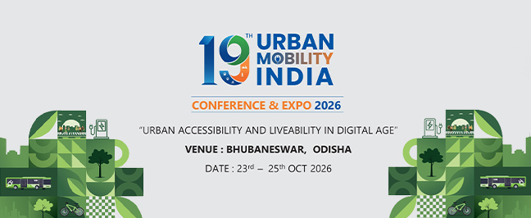
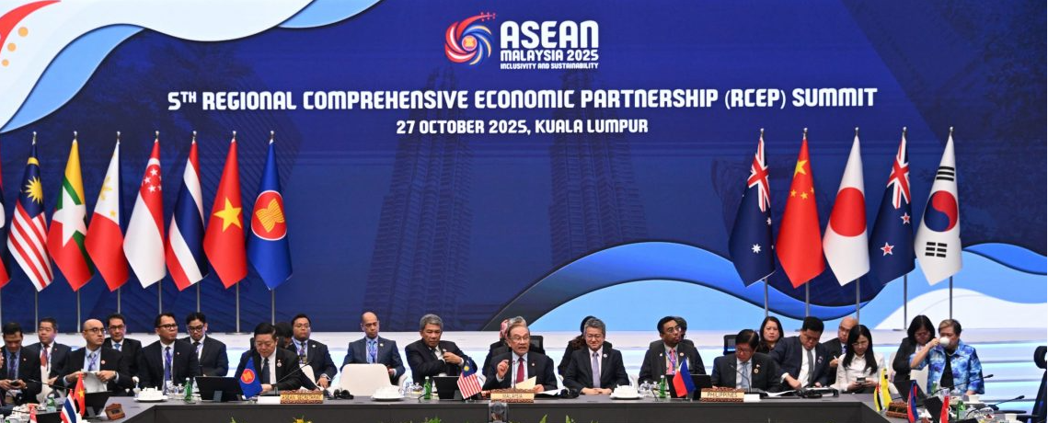


Key Convening and collaboration platforms
Key Publications –
Public Transport in LMIC countries
Inequalities in Mobility and Transport
OPEDs / BLOGs-
Maxing out benefits: Accelerating Bus Deployments in LMIC
E - IPTs : Game changer in Global South
Maxing out the Middle - Microbuses in Global South as solution
Missing Middle in India - Where are our micro and mini-buses?
Journal Articles -
Accelerating the Electrification in Public Transport and Para-Transit in cities of South and South-East Asia
Inequalities in Indian Mobility
Economic impacts of electrification for clean air in Delhi-NCR region.
Urban Mobility India conference – 2026 and 2027
The sixth Regional Comprehensive Economic Partnership (RCEP) Summit
6th IRF Asia-Pacific Regional Congress & 13th Malaysian Road Conference
BOSCH granted project- benefits of PT systems, sides of BRICS events

Slide 16
Thank you
ceew.in | @CEEWIndia

