Slide 1
Fully funded Fellowships and Internships for colleagues in Local Authority settings
Scott Lloyd
Advanced Public Health Practitioner & NIHR Doctoral Fellow
Middlesbrough Council and Redcar & Cleveland Borough Council
Notes:
SCOTT

Slide 2
Acknowledgements and contents
These slides were originally created by Dr. Mal Palin at the NIHR Academy
Contents:
  What is the National Institute of Health and Care Research (NIHR)
  The NIHR Fellowship Programme and other opportunities
  Getting the word out
  Support to apply
  Questions and (attempted) answers
Notes:
SCOTT

Slide 3
The National Institute for Health and Care Research (NIHR)
The NIHR funds, enables and delivers world-leading health and social care research that improves people's health and wellbeing, and promotes economic growth.
Funded by the Department of Health and Social Care, NIHR spends £1.3bn delivering world-leading research (2022-23)
Notes:
SCOTT

Slide 4
NIHR Academy
The NIHR Academy attracts, trains and supports highly skilled academic researchers.
Open to colleagues working in Local Authority settings – specifically applicants must hold a contract of employment in England with either a:
  Local Authority;
  Provider of Local Authority commissioned services; or a
  Non-profit organisation (such as a charity) that provides services on behalf of a Local Authority, or that otherwise supports a Local Authority in meeting its objectives.
England only, but equivalent schemes exist in the devolved nations
Notes:
SCOTT

Slide 5
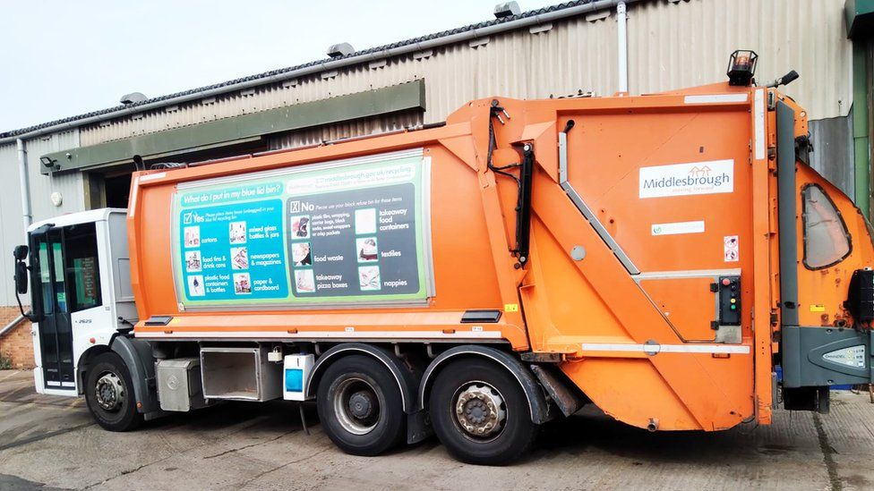


Who is eligible?
Notes:
SCOTT

Slide 6
Internships (examples)
Grassroots awards (for public health focused ideas)
  Up to £5,000
  Irregular, new round of funding opening in April 2026
NIHR Internships for registered health and care professionals (Social Workers & UKPHR registered public health colleagues)
  Up to £10,000
  Annual competition, regionally implemented with varied closing dates (cohort two likely to be Autumn/Winter)
Local Authority Short Placement Award for Research Collaboration (LA SPARC)
  Up to £15,000
  Annual competition, deadline in November
  Can operate LA -> academia OR academia -> LA (Academy members only)

Slide 7
Pre-doctoral Fellowship
Supports aspiring practitioner academics (excluding doctors and dentists) settings to become competitive applicants for a doctoral fellowship
Covers:
  Salary costs (time undertaking the Fellowship), up to one year FTE with options between 0.3fte and 1.0fte (maximum duration of 40 months)
  Full Masters fees at the UK rate or £5,000 bespoke Masters-level training
  £1,000 for working with people and communities, previously known as patient and public involvement, and research inclusion
  £1,000 supervisory fees
  £1,000 conference fees and associated travel and subsistence
Applicants with a relevant Masters qualification are able to apply, with the expectation that they would have an award of a shorter duration e.g. 6 months
Notes:
SCOTT

Slide 8
Doctoral Fellowship
Funds aspiring practitioner academics to undertake a PhD by research and, concurrently, to undertake professional development and retain a practice role
Funding and support
  3 years FT (with part-time options)
  Funds salary (for academic time and practice time), research costs, academic training costs (inc. PhD fees), professional training & development costs, and the costs of research visits and conference attendance
Practice Time: ~20% of award time must be dedicated to development of the awardee’s service or practice role, which will be funded through the fellowship
Notes:
SCOTT

Slide 9
Other schemes
The NIHR Post Doctoral Fellowship – for those with a PhD in Local Government settings.
The NIHR Pre-Application Support Fund - provides extra support to those who need it, to enhance their chances of making a successful application to an NIHR career development scheme in the future.
Irregular opportunities:
  NIHR Three Research Schools masters scholarships
Notes:
SCOTT

Slide 10
What these awards fund
Staff time, allowing backfill
Travel, accommodation and subsistence to undertake the short placement
Relevant short training courses
Conferences
Public involvement monies

Slide 11
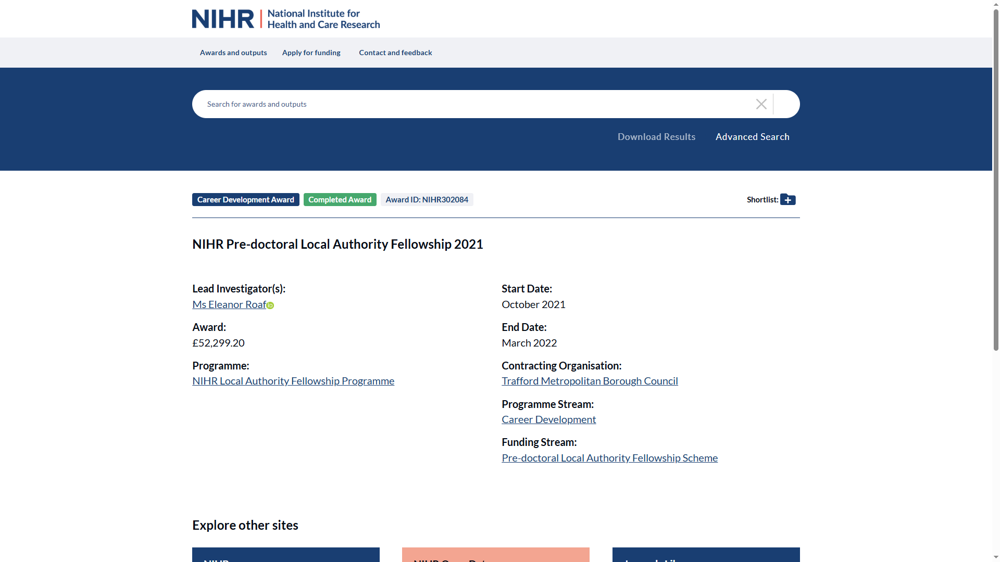

Slide 12
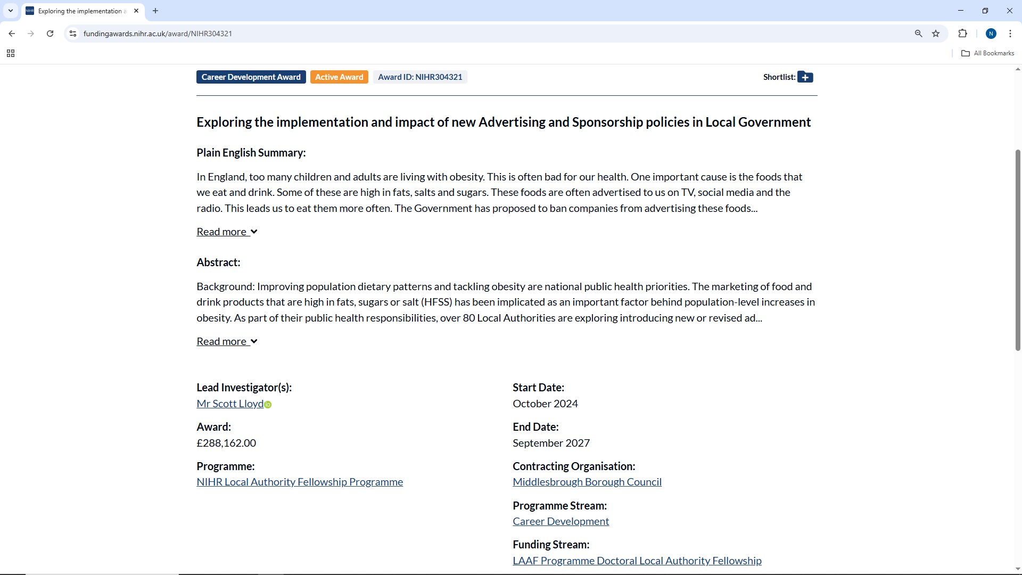

Slide 13
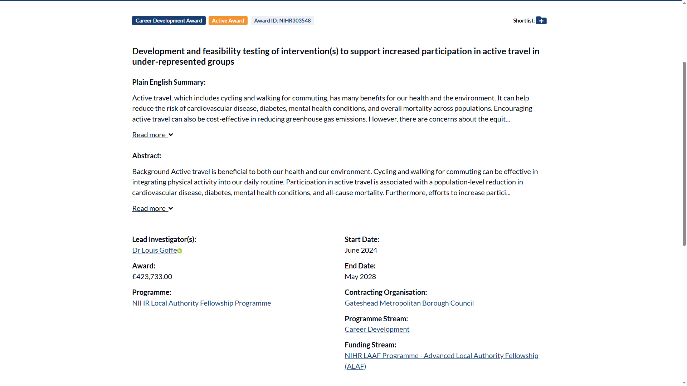

Slide 14
Key dates
Key dates:
  Predoctoral Award, opens January and closes March
  Doctoral Award
    Window 1: opens April and closes June
    Window 2: opens November and closes January
  Post Doctoral Award
    Window 1: opens April and closes June
    Window 2: opens October and closes December
Rough rule of thumb – strong applications take >six months
  Seek support ASAP
Notes:
SCOTT

Slide 15
Questions so far

Slide 16
Other funding
Notes:
SCOTT

Slide 17
Other options
Other funders
  UK Research and Innovation
    Arts and Humanities Research Council (AHRC)
    Economic and Social Research Council (ESRC)
    Natural Environment Research Council (NERC)

Slide 18
Other research funding in NIHR
NIHR Public Health Research Programme
  Researcher led
  Commissioned calls
  Continuing areas of research interest to the PHR Programme

Slide 19
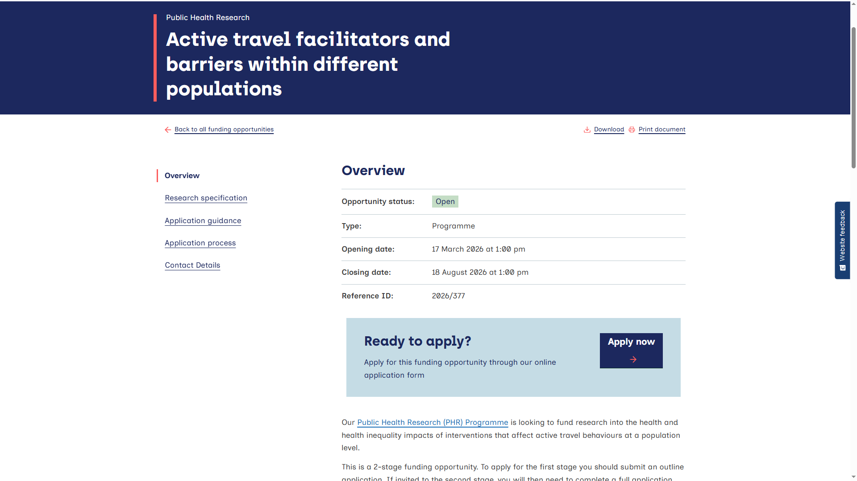

Slide 20
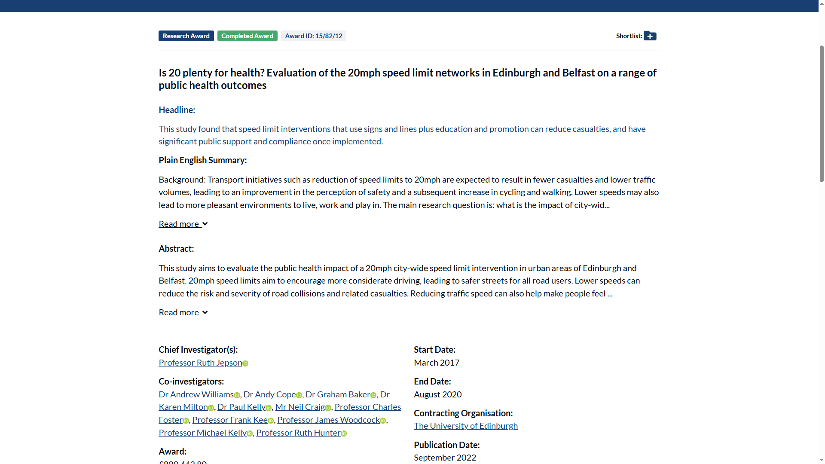

Slide 21
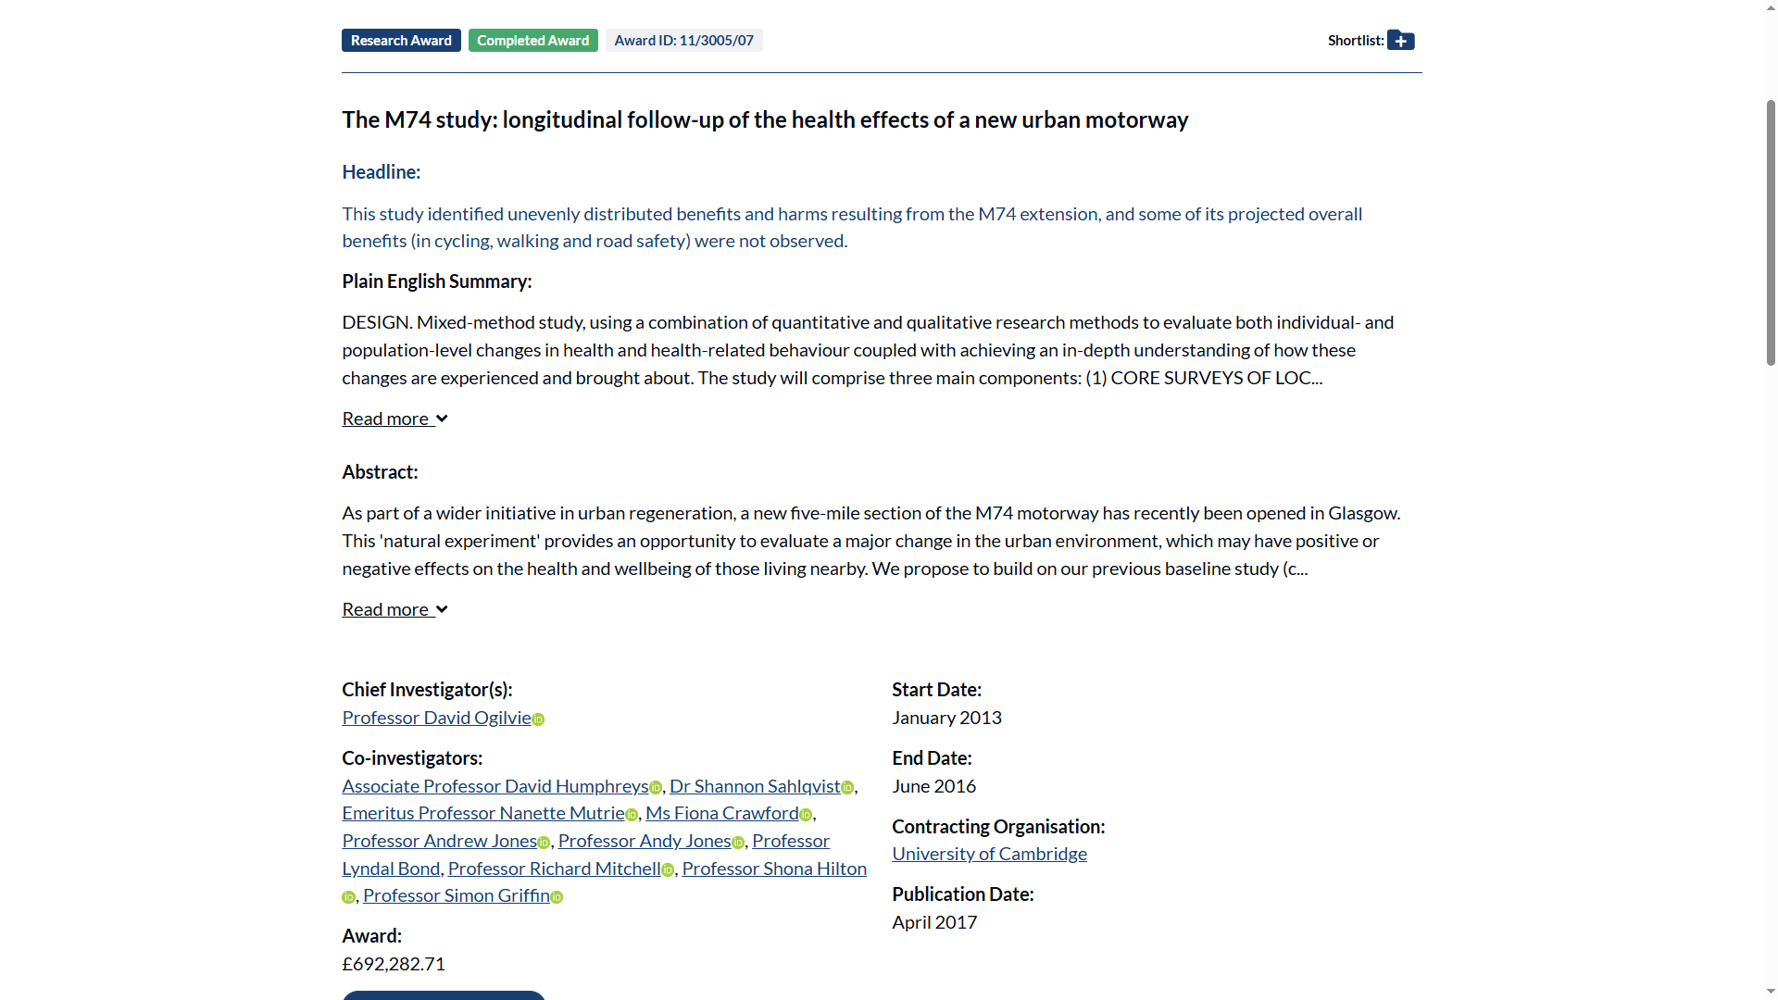

Slide 22
Support to apply and encouraging applications via THSG
Notes:
SCOTT

Slide 23
Encouraging applications via THSG
NOT just for Public Health folk
I can do webinars or stuff for comms/website
Also have recorded webinars
But what else?

Slide 24
Support to apply
Peer support - https://tinyurl.com/yffft2m3
NIHR RSS Hubs and Specialist Centres for Social Care and Public Health
  Thinking through and specifying research questions
  Finding collaborators and partners, including academic supervisors
  Financial support for public and community involvement
  Design and methodological advice
  Example funded application forms
  Peer reviewing your ideas and proposals
  Mock interviews (doctoral level and above)

Slide 25
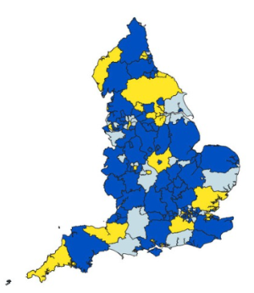
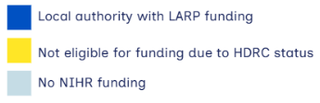
Local Government Research Infrastructure
NIHR Health Determinants Research Collaborations
  30 competitively funded across the UK
  £5 million each over five years
Local Authority Research Practitioners
  90 LARPs funded
  Covering 95 Local Authorities (England only)
When combined with the investment into the NIHR RSS Specialist Centres for Social Care (two) / Public Health (two), this represents an investment of ~£190 million (2023 to 2028)

Slide 26
Summary
Loads of opportunities
NOT just for public health folk
Fully funded
There will be organisational challenges to applying
Notes:
SCOTT

Slide 27
Contacts and questions
RSS Specialist Centre for Public Health support: https://rss-scph-database.ncl.ac.uk/enquiry/contact
RSS Specialist Centre for Social Care support: https://nihr-rss-socialcare.york.ac.uk/
Recorded webinars - https://sites.google.com/view/nihrrssscph/news/read-more/catch-up-nihr-personal-awards-webinars
English Local Government Fellowship forum: https://tinyurl.com/yffft2m3
Notes:
ALL

