Slide 1
Making & publishing THSG’s policy recommendations
Dr Jennifer Mindell
THSG Company Secretary & Treasurer-Elect
Member of Policy Committee

Slide 2
THSG Policy recommendations
Name change from ‘Policy’
Where not feasible in short term (funding, context, etc.) but a longterm goal, also include ‘vision’ and suggestions for policies in shorter term
Aiming to be globally relevant
  Principles if not entire content

Slide 3
Process
Summarise evidence – find or create
Board prioritization of two (three if time)
  2026:
    Inequalities
    Economics and finance
    opportunistic
Find volunteers to lead and to contribute
Draft created
Reviewed by Policy Committee
Reviewed by Board
Accepted policy recommendations published on THSG website

Slide 4
Format
Three versions to be published:
  Main document (8pp)
  Summary (3pp)
  Key points (1pp)
  Appendices if needed
Referenced version of main document
Uniform formatting
‘THSG believes’ not ‘We believe’

Slide 5
Say
The 8pp level should normally address outcomes, the ideal situation, and practical interventions in current settings.
The policy recommendation documents should recognise different contexts (e.g.
  cities/ rural areas/ remote areas
  HICs/ LMICs) and
  different user groups (e.g. gender, disability) from the outset
References should be identified as the document is written
  but only the most important and controversial points should be directly supported by references in the main document.
  However, a version with full references should be available.

Slide 6
Standard text to include in all THSG policies (1)
The links between transport and health are supported by robust evidence.
Ensuring prosperous and healthy cities, communities and individuals requires going beyond reducing carbon emissions.
Decision-makers need to recognize these links and actively promote policies and interventions that reduce harmful environmental exposures linked to transport while promoting sustainable and active mobility.

Slide 7
Standard text to include in all THSG policies (2)
The health impacts of transport affect people of all ages and backgrounds throughout their lifetime, although some populations such as children, older people, and those with lower incomes, disabilities, and/or from minority ethnic groups can be especially vulnerable.
A holistic approach to urban planning, environmental, transport energy and climate issues should be adopted, and is urgently needed.

Slide 8
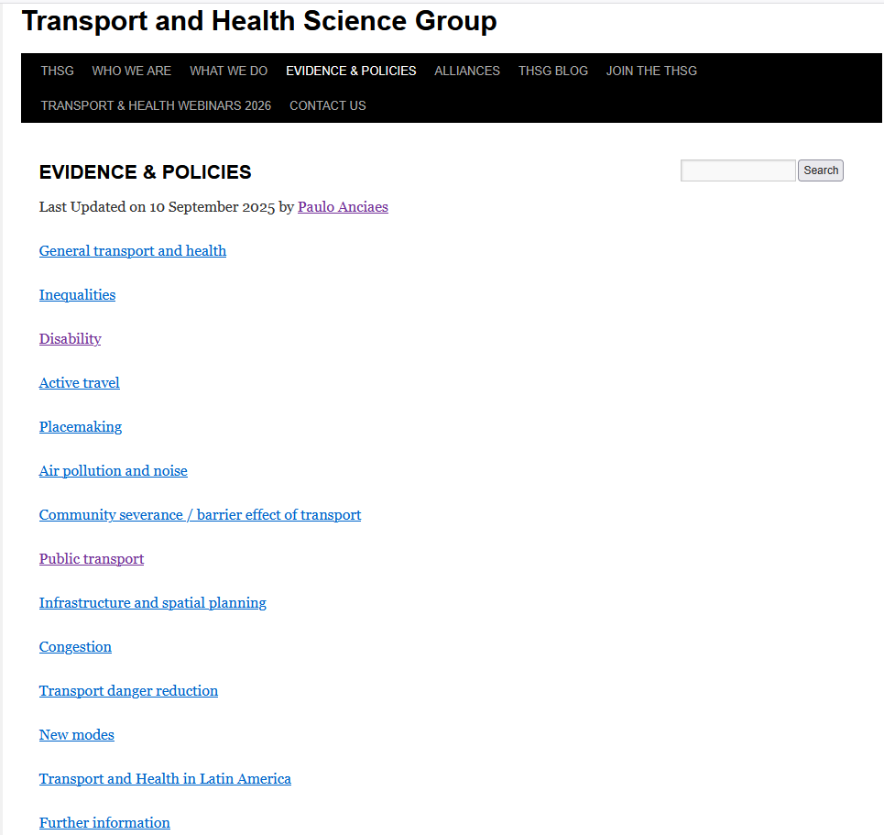

Slide 9
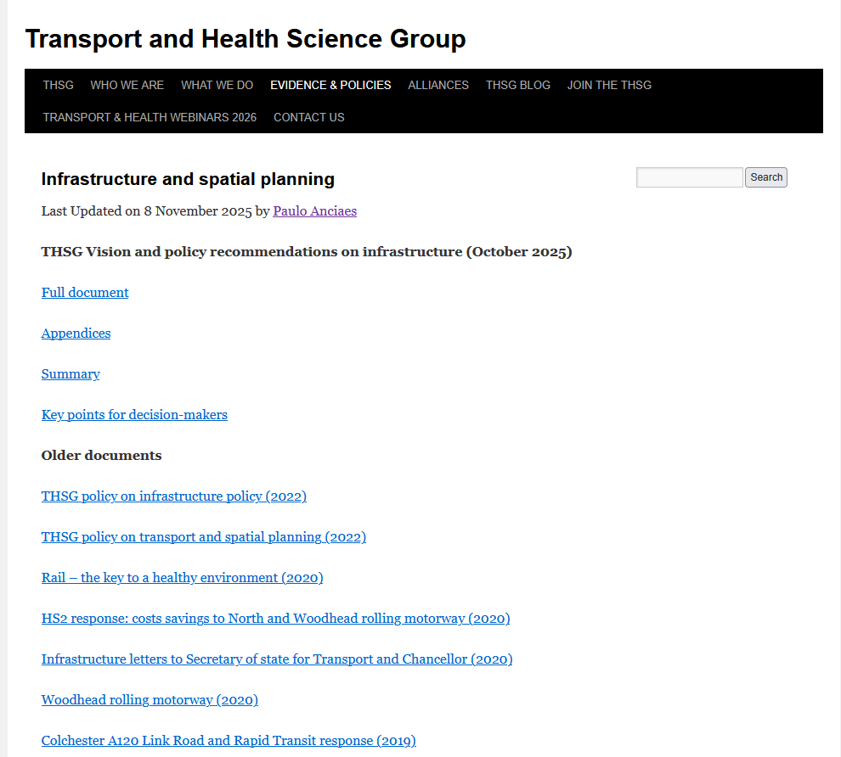

Slide 10
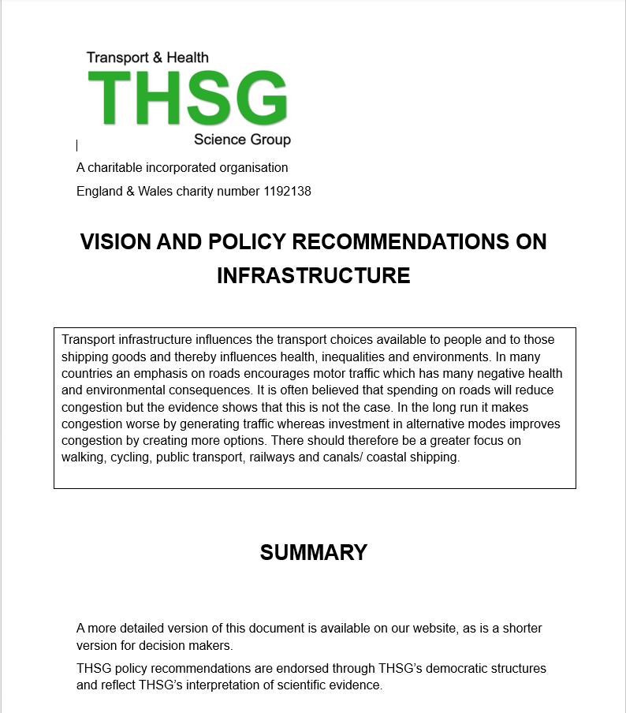

Slide 11
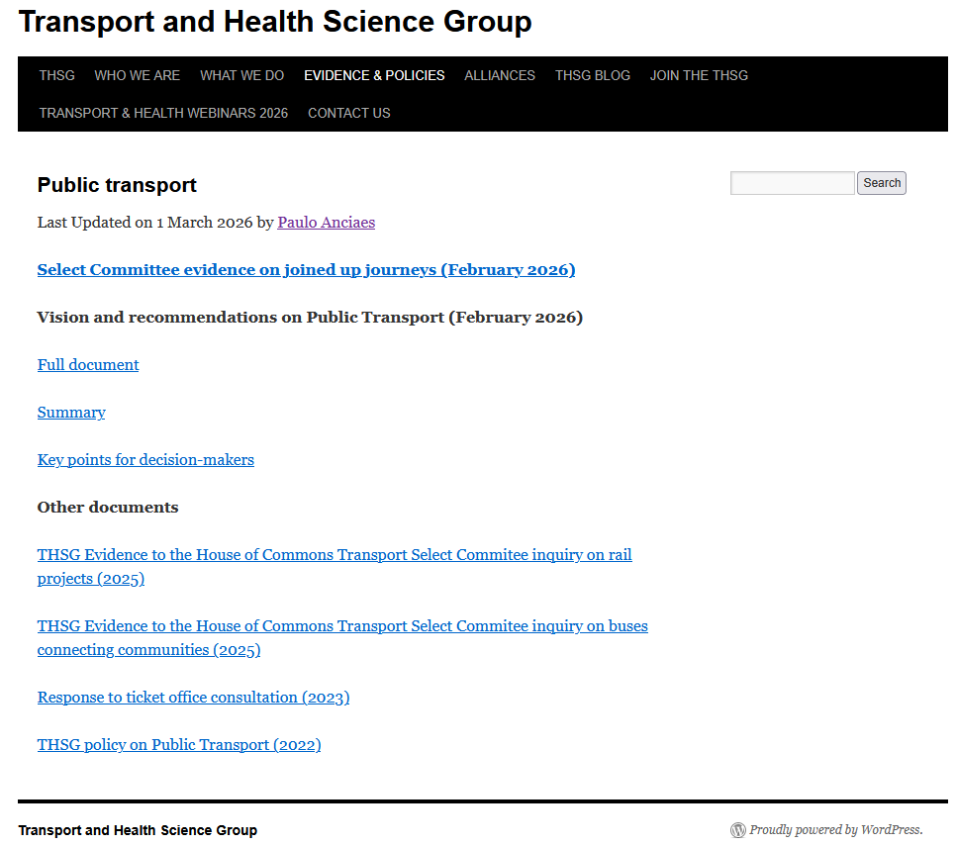

Slide 12
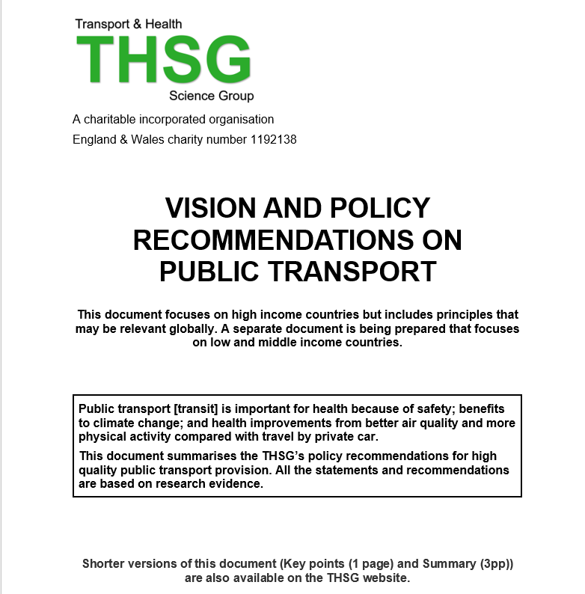

Slide 13
PT in LMICs
Himani Jain & colleagues working on a separate set of policy recommendations for LMICs
When approved and on THSG website, this existing one will be changed to include HICs in the title and in the website hyperlink.

Slide 14
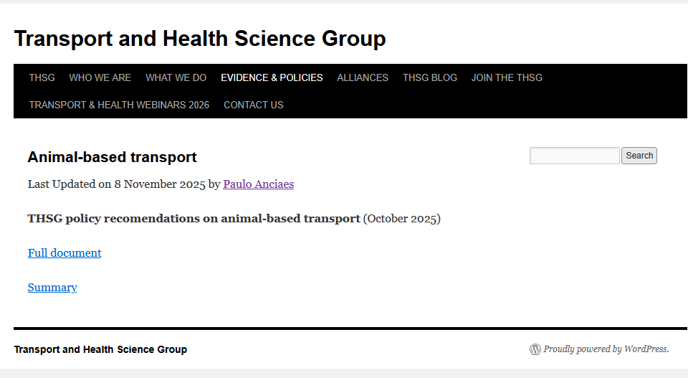

Slide 15
Volunteers wanted
To amend existing THSG policies into the new 1:3:8 format (and include the standard text)
To produce referenced versions
To lead on future policy documents
To contribute to drafting new policy documents
To inform THSG if working on a T&H policy that could be co-badged with THSG
To join regional committees & the Board – especially if from LMICs

Slide 16
HotM3 - The Other Volumes
Under Way
  HotM3: The Reviews volume 1
  HotM3: The Reviews volume 2
  HotM3: The Policies
Still to Come
  HotM3: Placemaking
  HotM3: Best Practice Guidelines
  HotM3: The Update

Slide 17
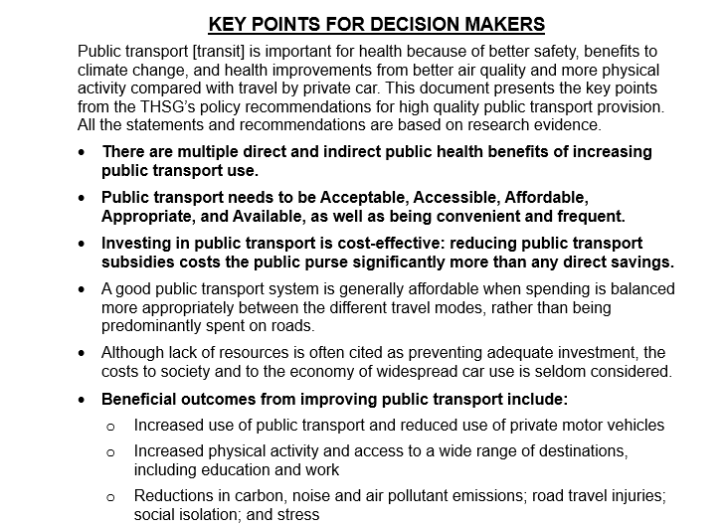

Slide 18
